Slide 1
Overfitting & Underfitting

Slide 2
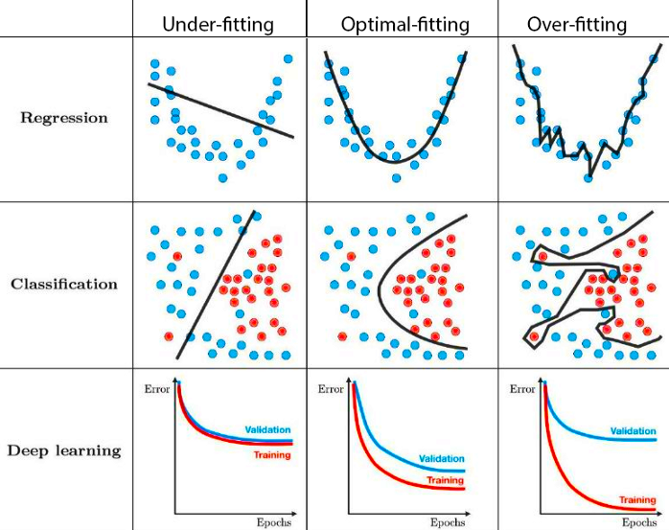

Slide 3
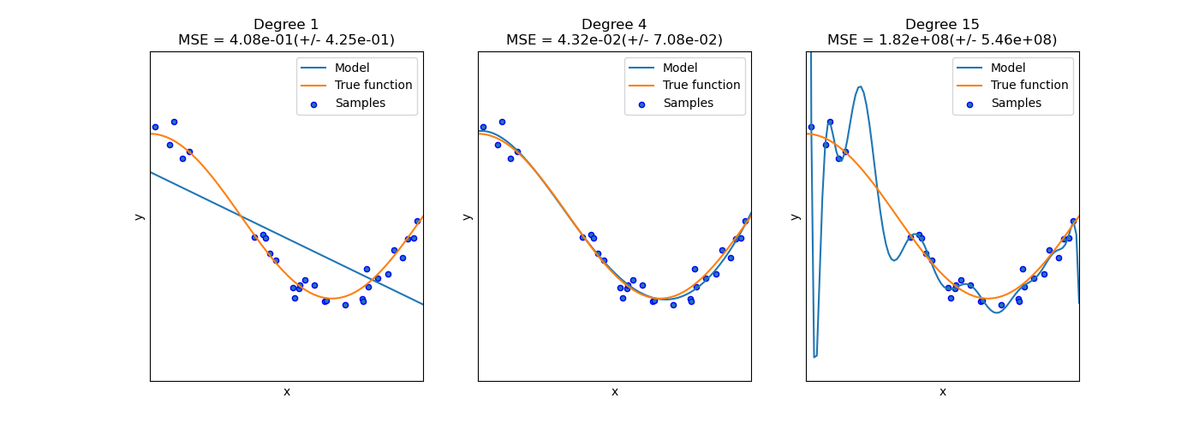

Slide 4
